Slide 1
Problem solving by searching

Slide 2
Searching Technique
Informed search
Uninformed search

Slide 3
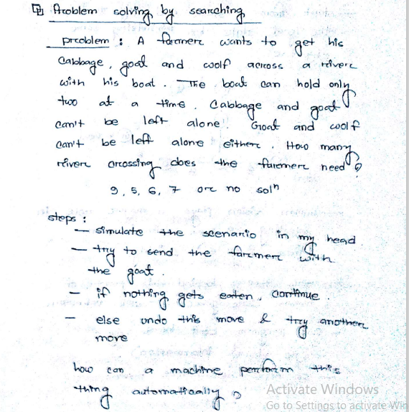
Problem solving by searching(example)

Slide 4
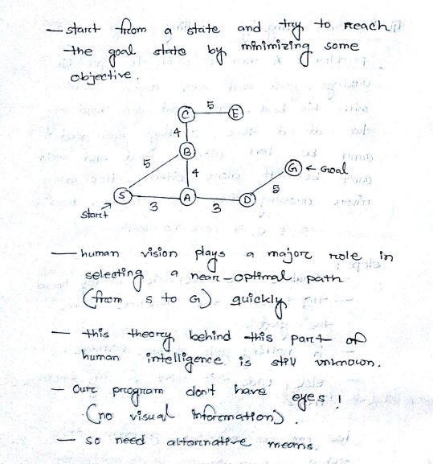
Searching example

Slide 5
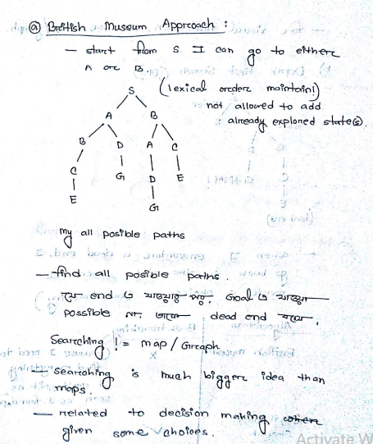
British Museum Approach

Slide 6
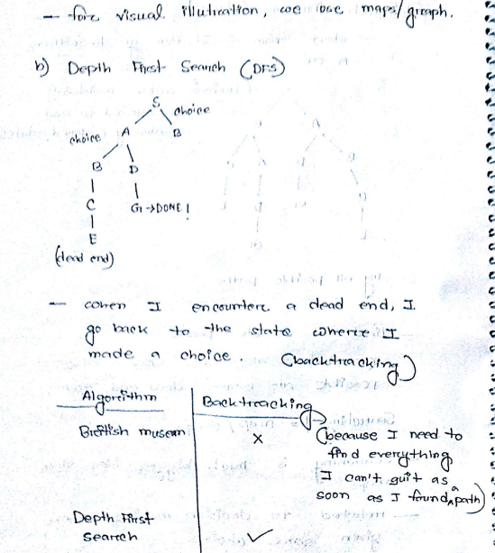
Depth First Search

Slide 7
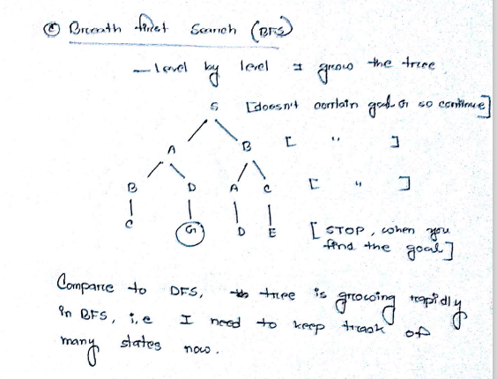
Breath First Search

